Slide 1
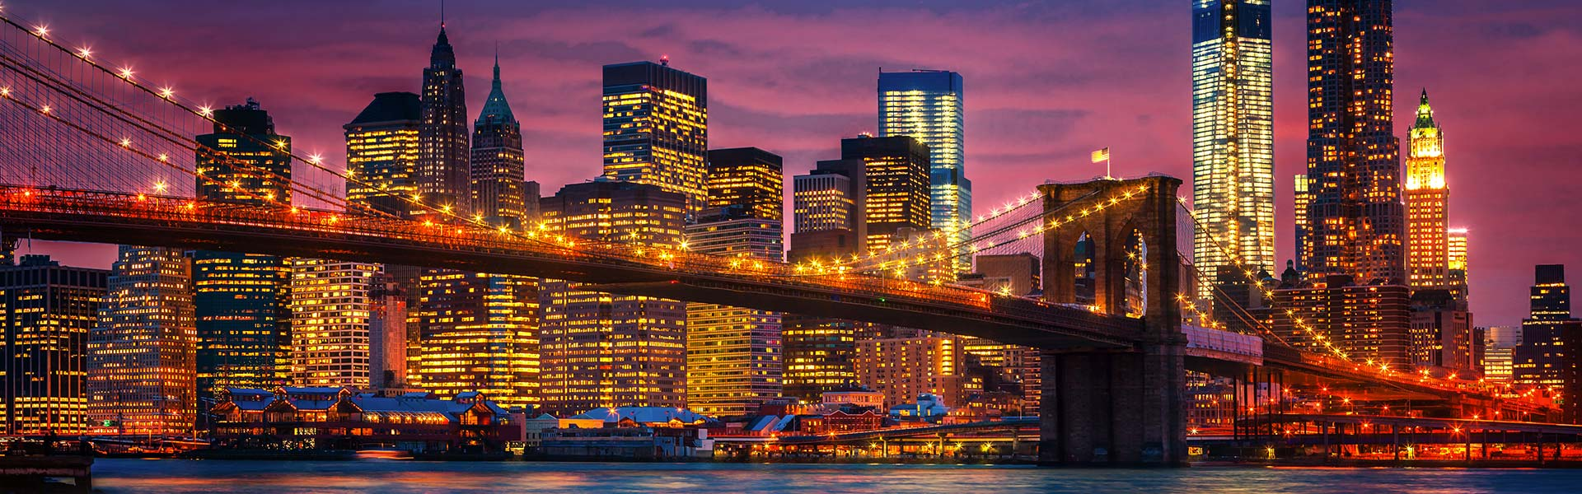
New York’s Preference in What Cup of Drink
Marc Huai

Slide 2
Background/Problem
Where is the most densely populated city in the United States? Of course, it’s New York.
The United States consumes three times more coffee (75.4%) than tea (24.6%).”
Let’s explore the profile for New York overall and each neighborhood.
A new business owner can identify neighborhoods
A potential resident could find a place to live based on their preferences for what type of drink.

Slide 3
Data Acquisition and Cleaning
NYU Spatial Data Repository: ‘2014 New York City Neighborhood Names’ dataset
Foursquare---’Places API’
Dropped null and out of NY values
Combined venue names with variation
In total, row and features

Slide 4
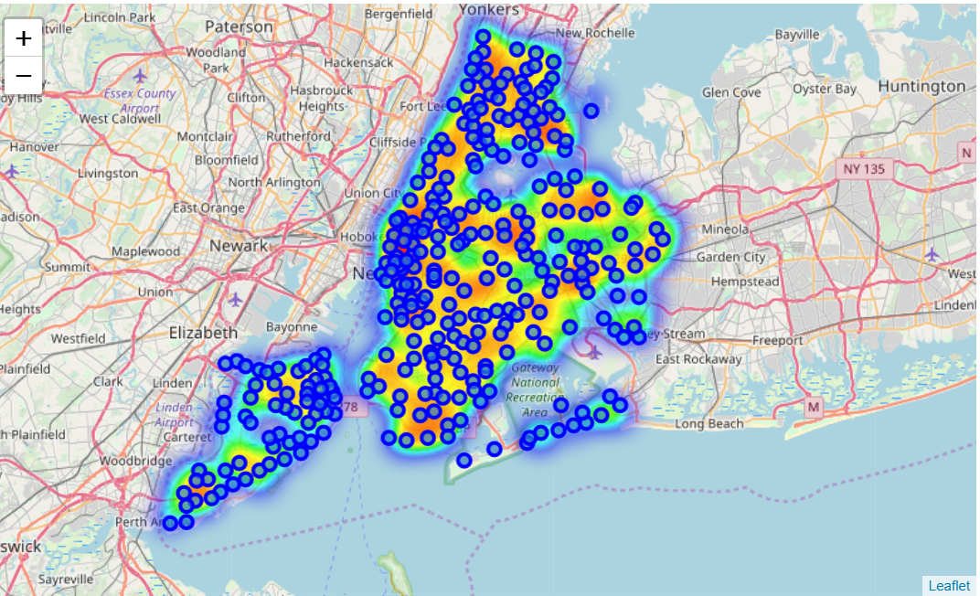
Heatmap

Slide 5
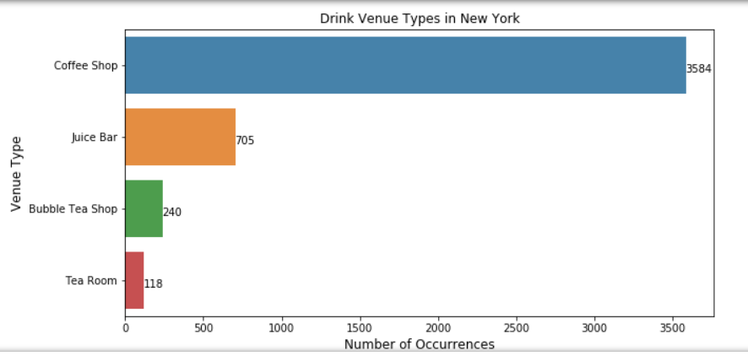

Slide 6
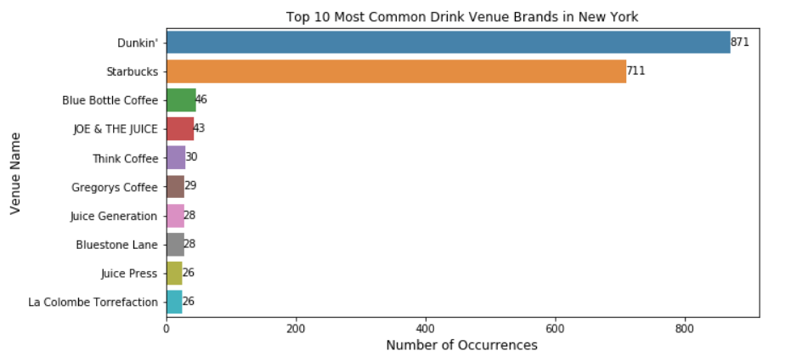

Slide 7
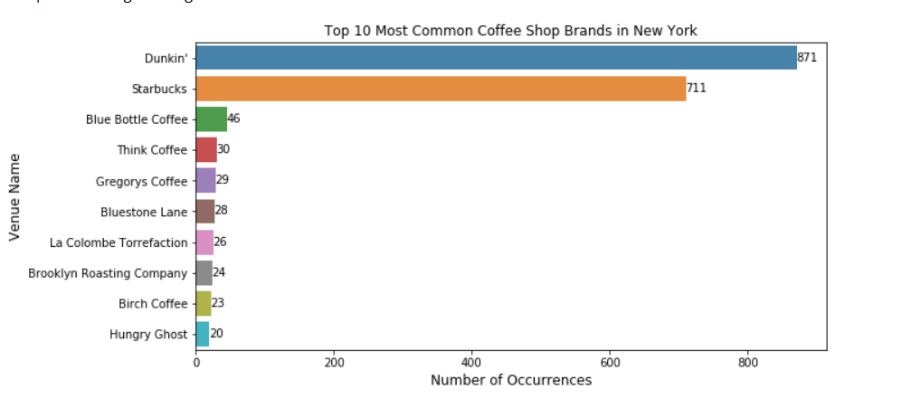

Slide 8
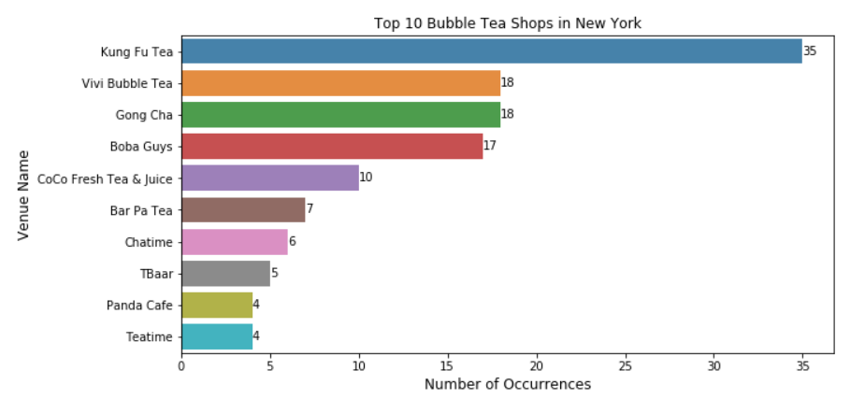

Slide 9
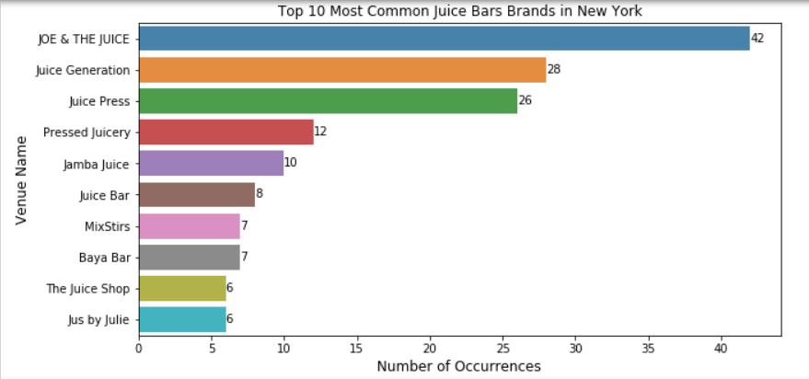

Slide 10
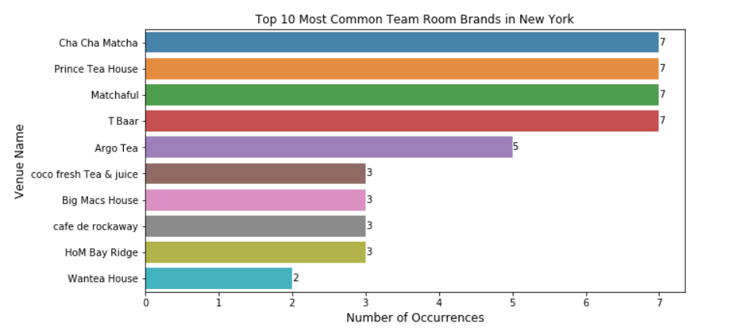

Slide 11
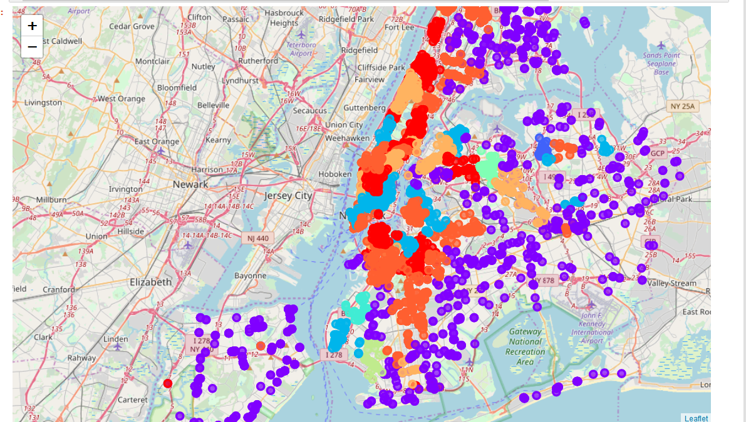

Slide 12
Results
Overall, Starbucks and Dunkin' Donuts dominate the space in drink venues.
The second most common drink venue type is Juice Bar.
Tea Rooms are the least common and make up 2.5 % of the entire drink market space.
One can look at the cluster profiles to see the similarities and differences between and within the clusters.

